Slide 1

Powerpoint
For Beginners

Slide 2





Course Outline
Introduction
Navigation
Overview of Screens
How to start a presentation
Inserting Icons, pictures

Slide 3
This course is mainly to increase the knowledge of students in the microsoft fields
Introduce
Overview
Features
We will cover these skills

Slide 4
Introduction
MS PowerPoint is a program that is included in the Microsoft Office suite. It is used to make presentations for personal and professional purposes.
First Skill
Second Skill
Third Skill
Conclusion

Slide 5



Overview
When you create a presentation using PowerPoint, the presentation is made up of a series of slides. The slides that you create using PowerPoint can also be presented as overhead transparencies or 35mm slides.
In addition to slides, you can print audience handouts, outlines, and speaker's notes.
You can format all the slides in a presentation using the powerful Slide Master which will be covered in the tutorial.
Second Skill
First Skill
Third Skill
Conclusion

Slide 6

Features
It has various features ranging from Home to Tell me what you want to do.
These various features makes the user to do their presentation very easily.
Home Screen includes changing font size, inserting new slides etc..
By insert ribbon menu we can insert new pictures from online as well as offline images.
From the Design ribbon menu it is easier to change the design of the slides.
Also we can use preloaded templates for our presentation.
Third Skill
First Skill
Second Skill
Conclusion

Slide 7
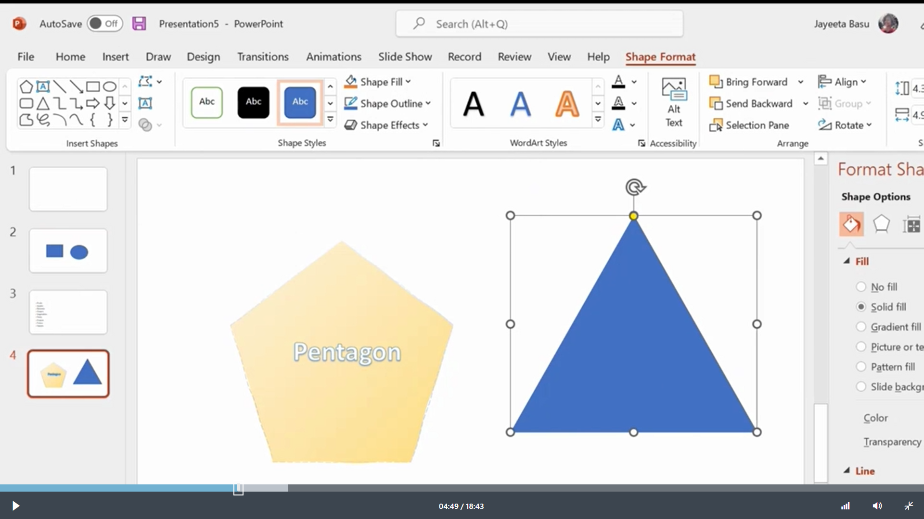
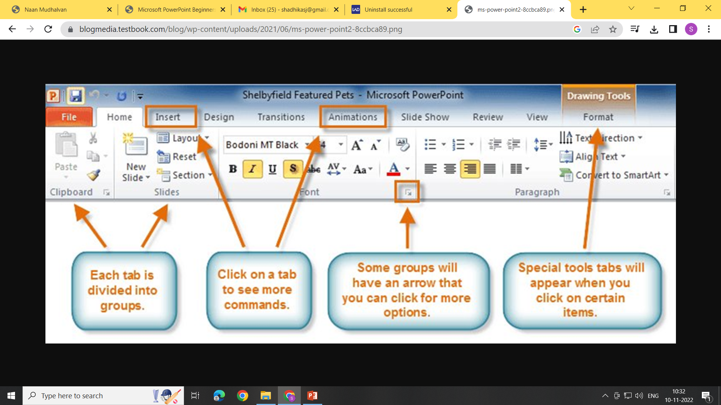
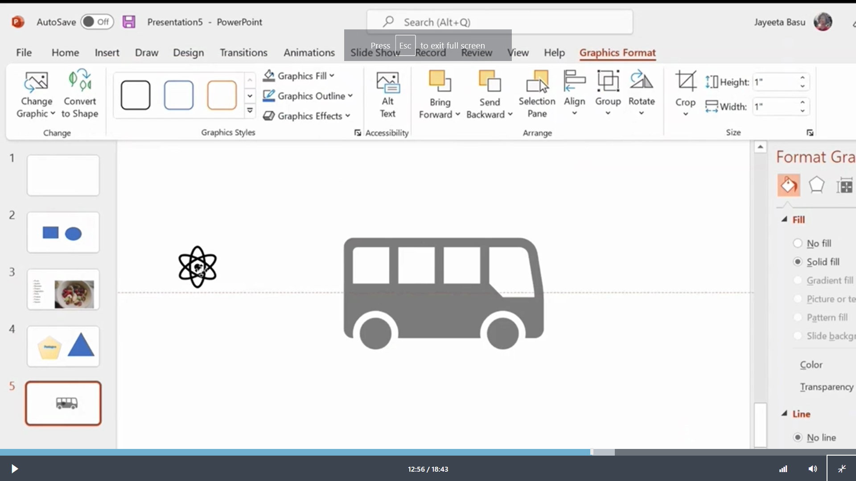
Conclusion
First Skill
Second Skill
Third Skill

